Slide 1




TRADE
Version 1.0

Slide 2
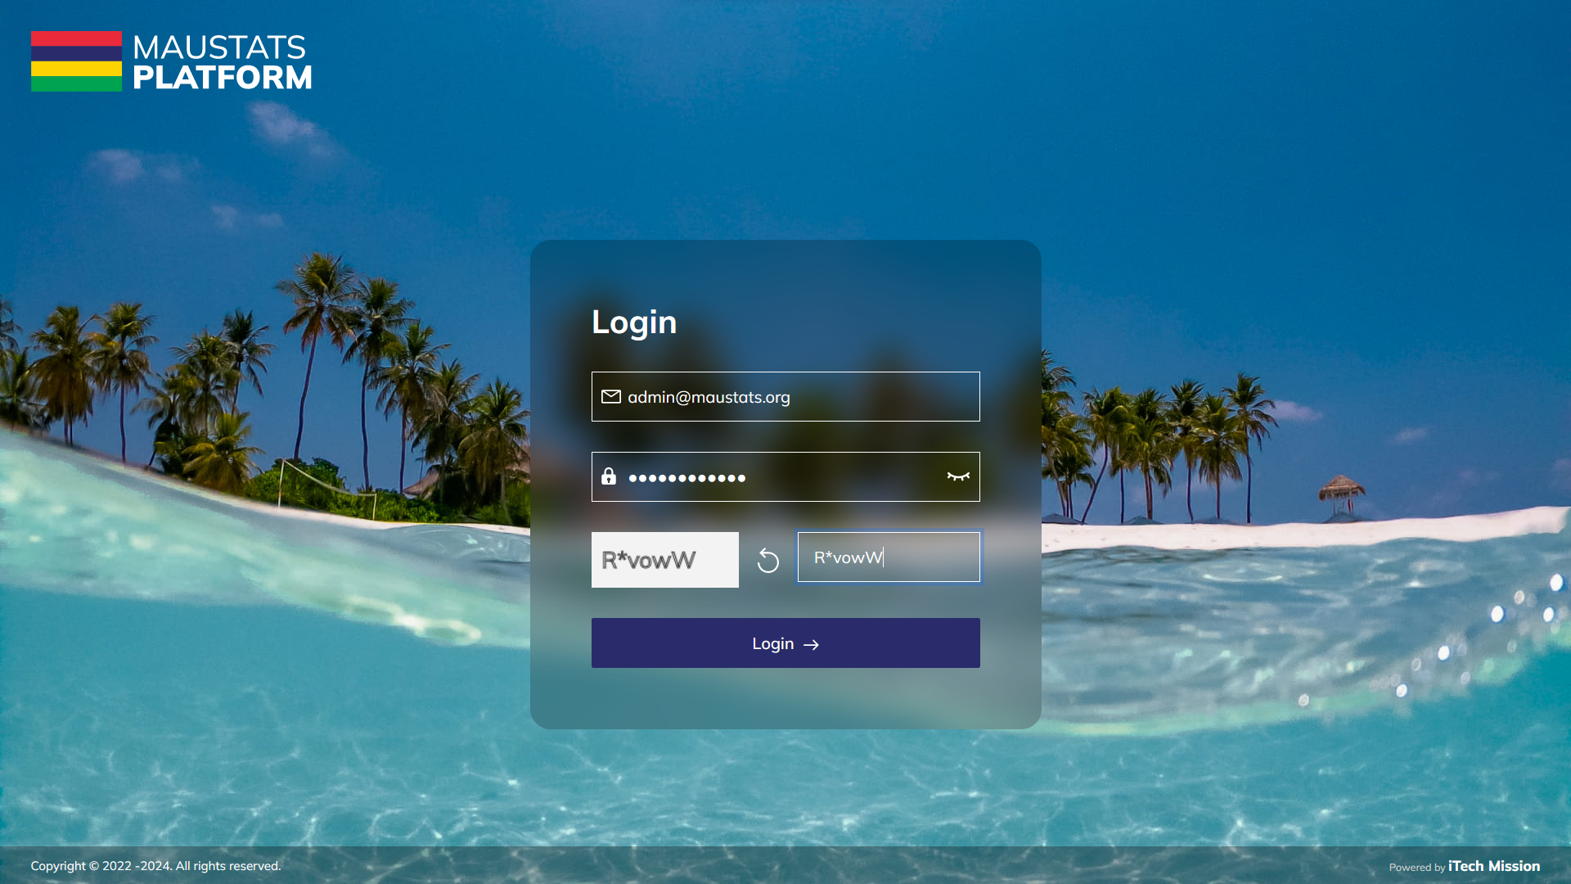
LOGIN
Login using valid credentials to access the Data Management System modules.

Slide 3
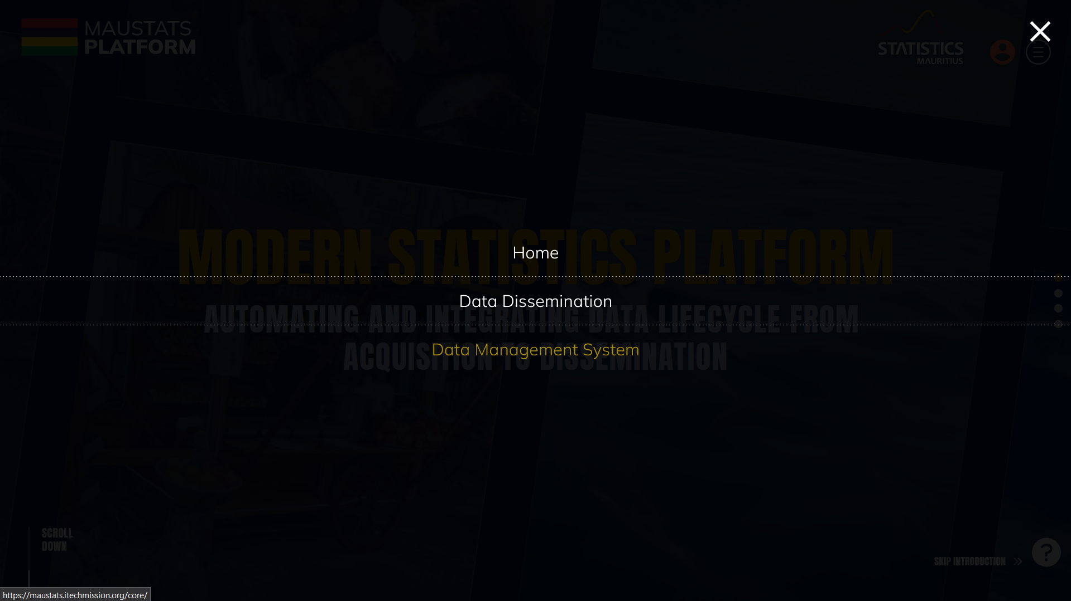
TRADE
To access Demography, click on burger menu and select Data Management System

Slide 4

TRADE
Transaction
Archive Transaction

Slide 5
1
TRANSACTION

Slide 6
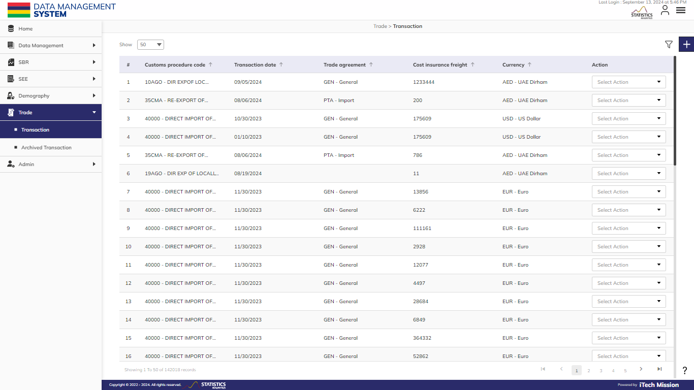
TRANSACTION
To manage Transaction, Select Trade – Transaction.

Slide 7
TRANSACTION
View existing Transaction data in tabular view. Click on the Plus button to add a new record.

Slide 8
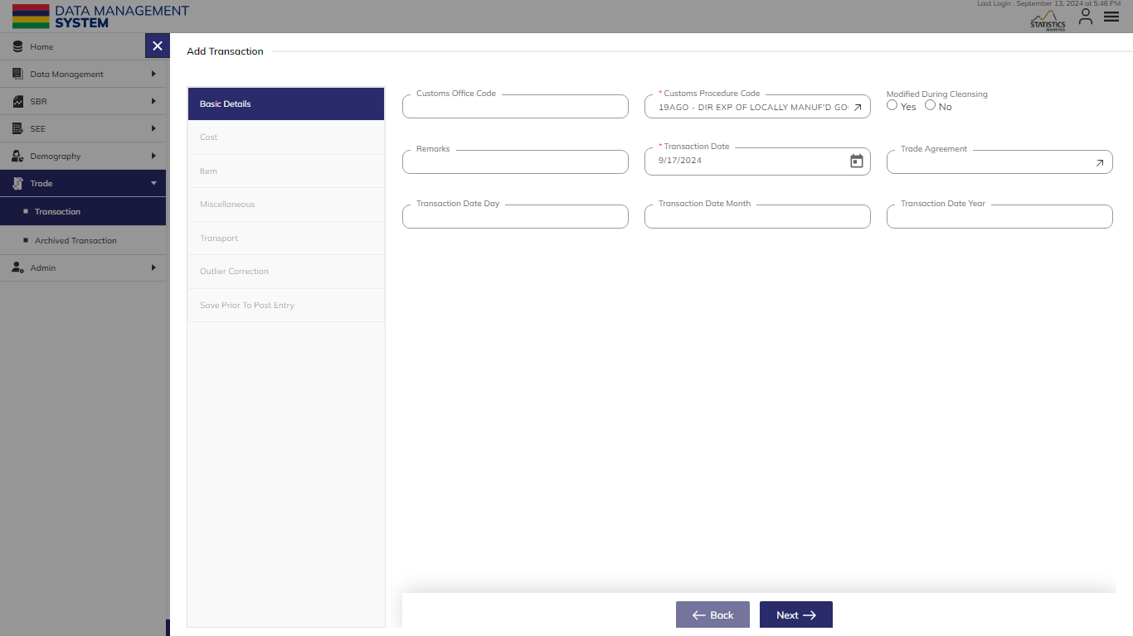
TRANSACTION
Enter Basic Details. Click on Next to Cost, Item, Miscellaneous, Transport, Outlier Correction, and Save Prior to Post Entry.

Slide 9
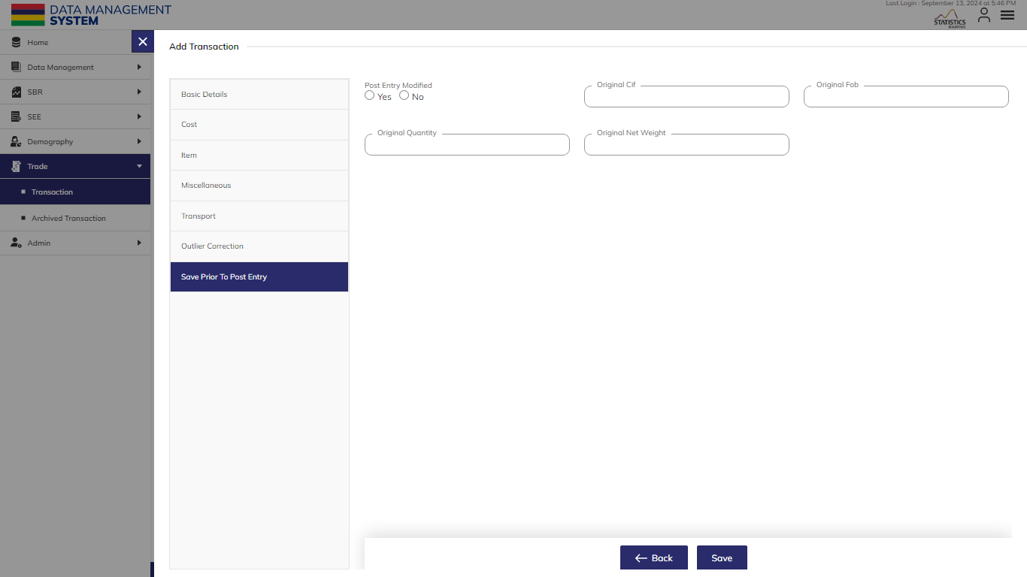
TRANSACTION
After adding the mandatory fields, the "Add" button will be available to click and save the record.

Slide 10
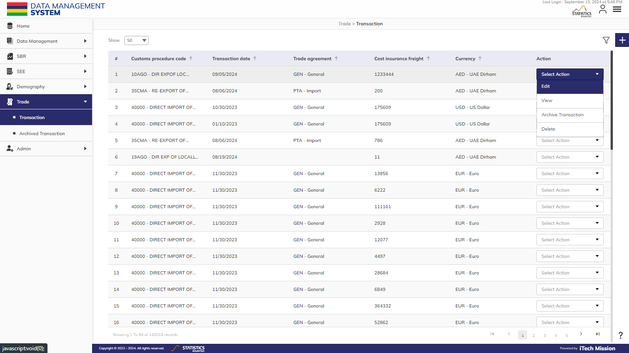
TRANSACTION
Click on the action dropdown to Edit, View, Enable/Disable, and Delete the selected record.

Slide 11
TRANSACTION
Click on Filter icon to apply filters and view filtered data.

Slide 12
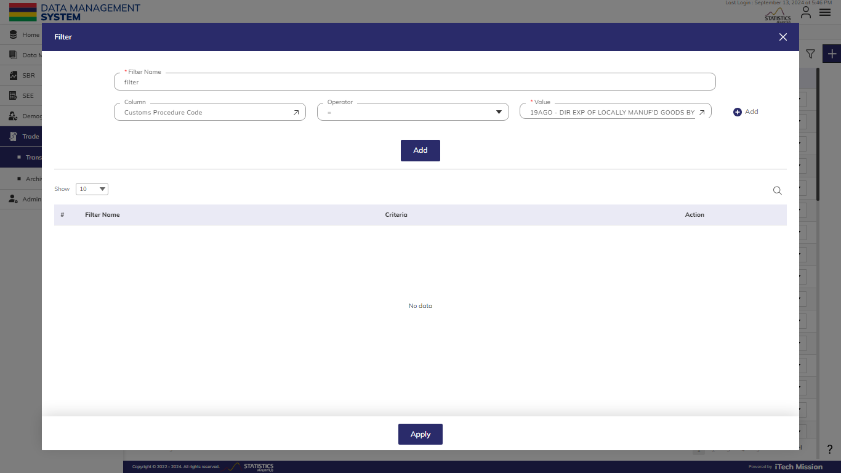
TRANSACTION
Enter the Filter Details and Click on Add to save the filter. Click on Apply to view the filtered data.

Slide 13
2
ARCHIVE
TRANSACTION

Slide 14
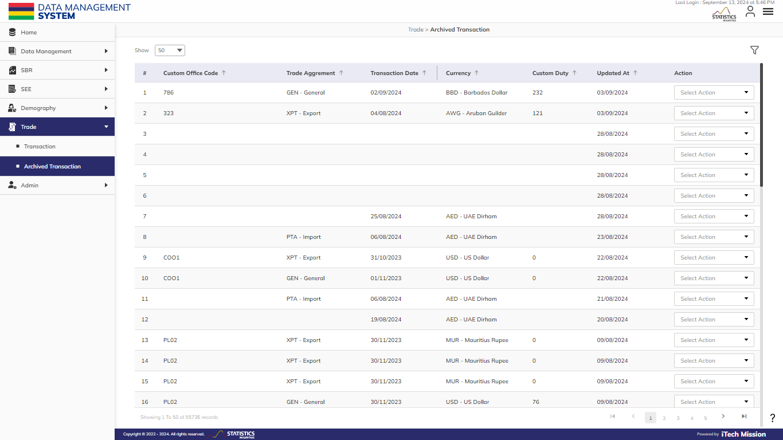
ARCHIVE TRANSACTION
Archive Transactions include Internal Transactions, Intermediate Transactions, And Transactions With Low Values (Less Than 1000).

Slide 15
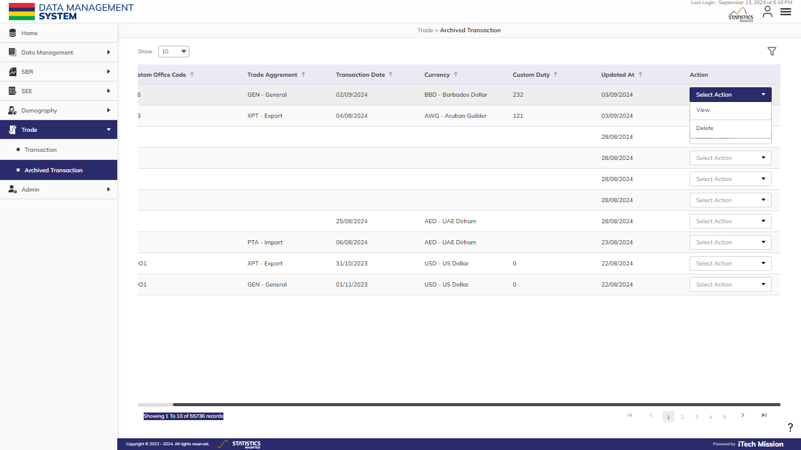
ARCHIVE TRANSACTION
Click on the action dropdown to View and Delete the selected record.

Slide 16
ARCHIVE TRANSACTION
Click on Filter icon to apply filters and view filtered data.

Slide 17
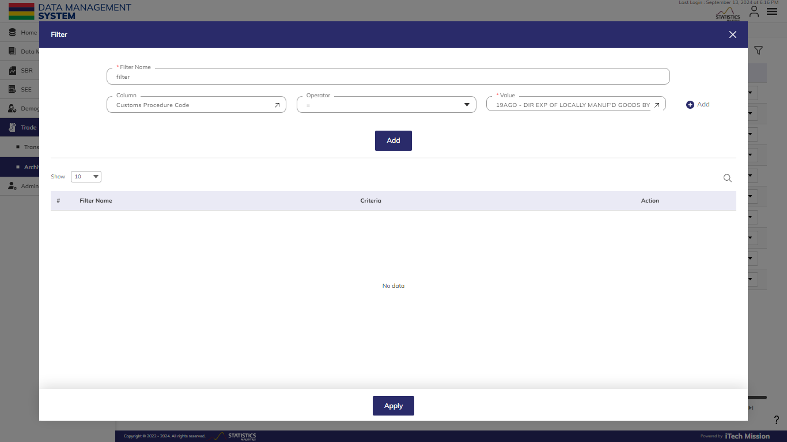
ARCHIVE TRANSACTION
Enter the Filter Details and Click on Add to save the filter. Click on Apply to view the filtered data.

Slide 18


